Slide 1

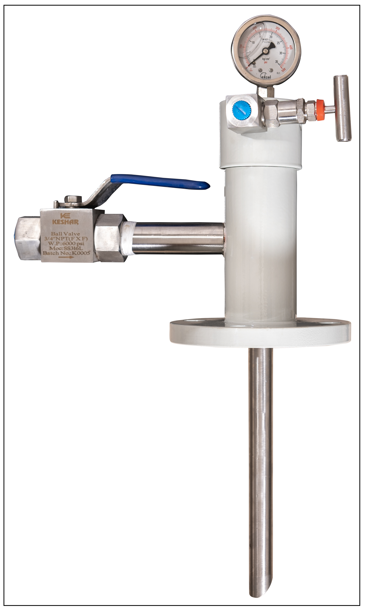
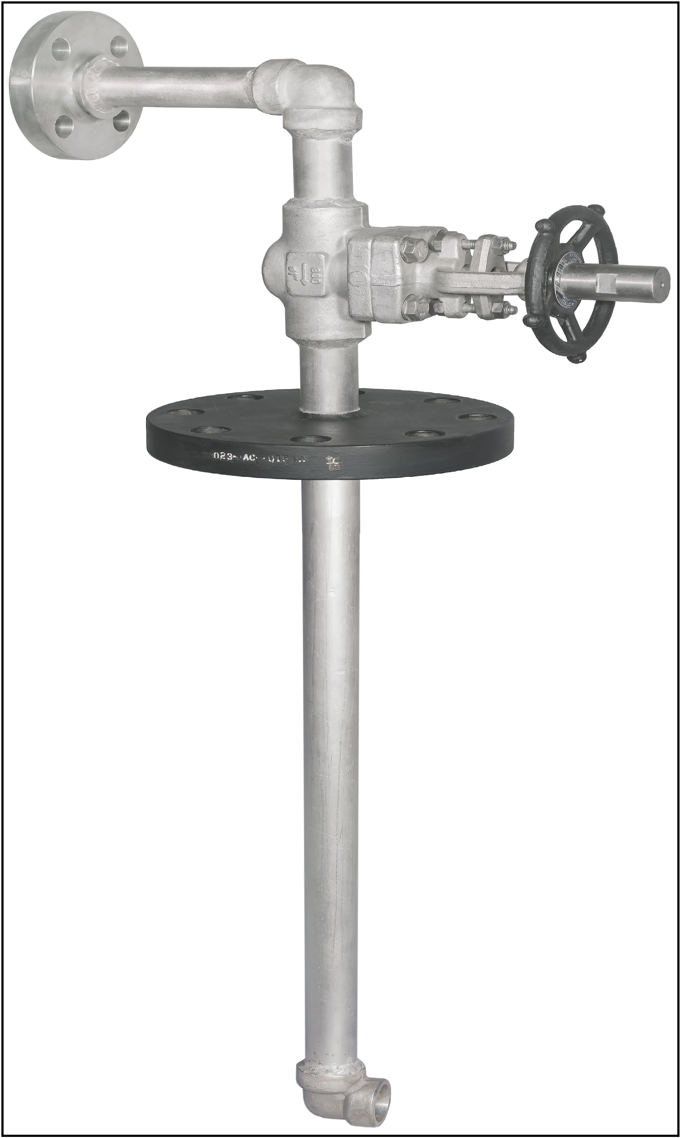
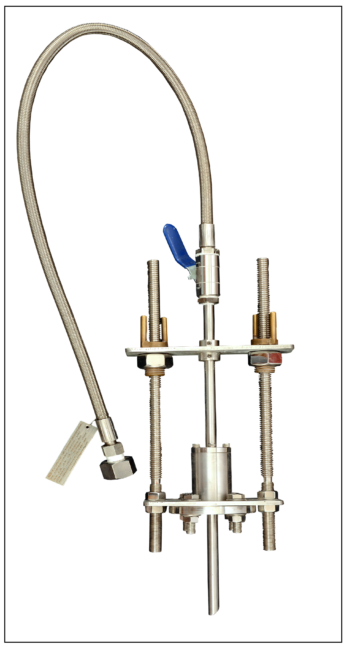
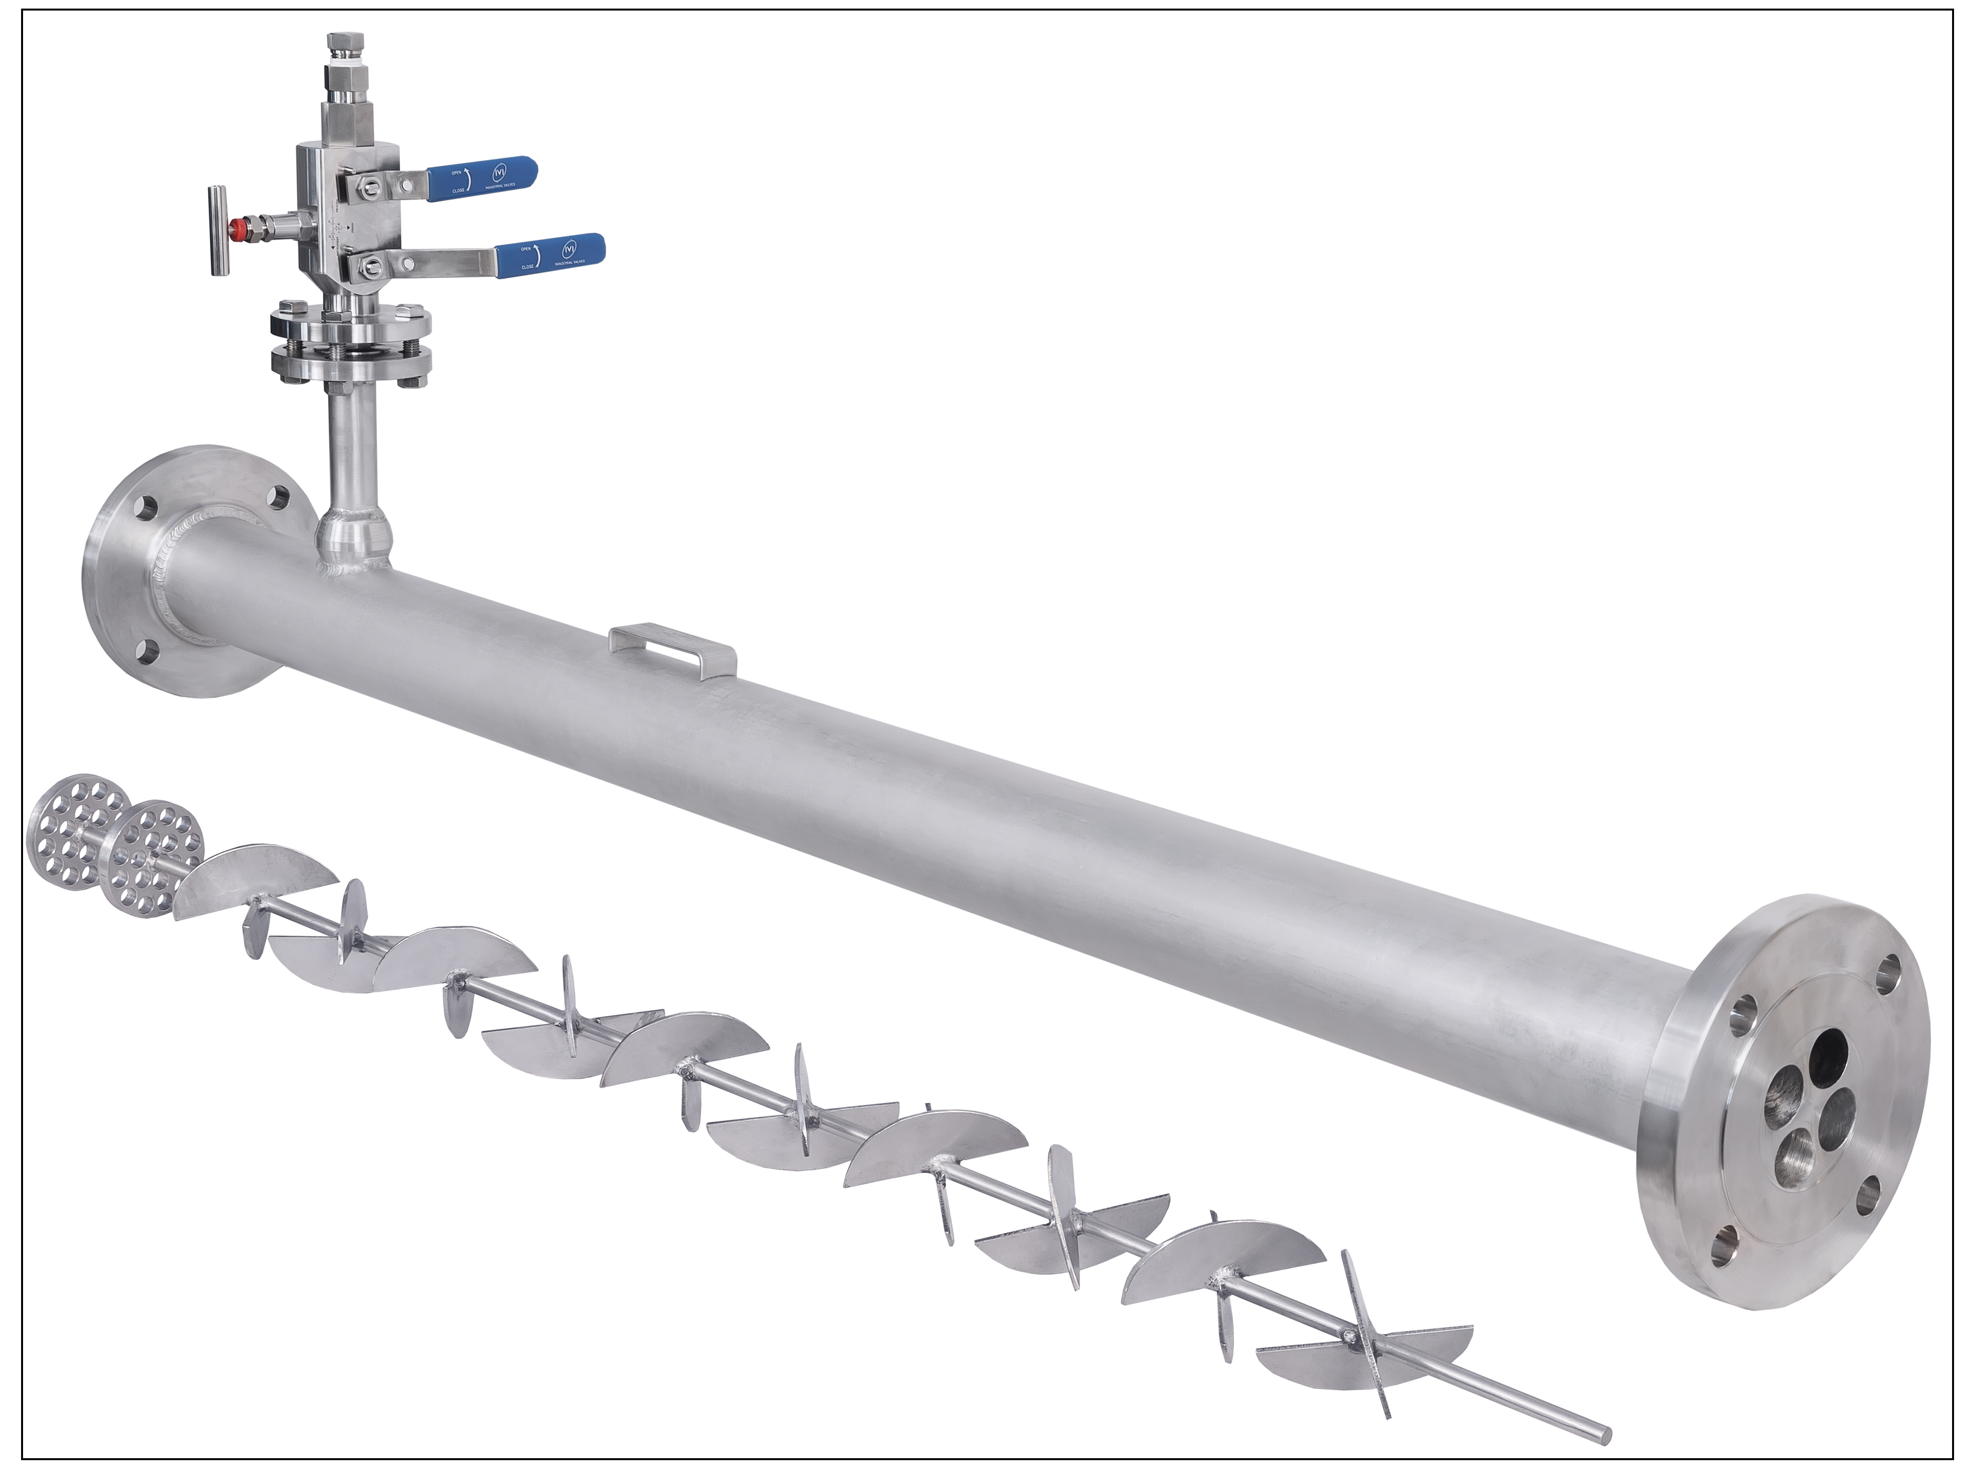
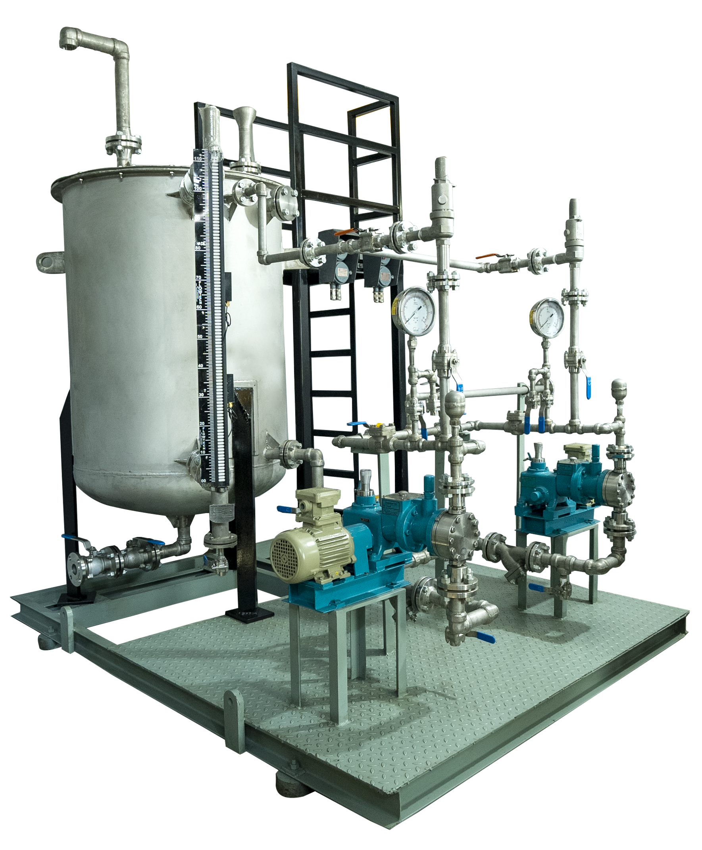
NND OIL & GAS
23, Anant Industrial Estate, Rakhial, Opposite to Comet Industrial Estate, Ahmedabad, Contact No:+91898011899, 9067590848

Slide 2
COMPANY OVERVIEW
NND Oil & GAS Company, delivering quality products with expertise to major industries from Oil & Gas, Chemicals, Fertilizer, pharma or any process industry in India and Overseas.
We design, manufacture, supply and commission products for the Oil & Gas, Chemicals, Fertilizer, Pharma or any Process industry in India and Overseas. Our expertise includes design & manufacturing of All types of chemical injection quills, Sample Quills/probes, Corrosion coupons, Inline static Mixer, Fluid measuring systems (Venturi meters, Orifice systems), Flame arrestor, Natural Draft & forced draft burners, Chemical Dosing systems, Pressure vessels, heater treater, storage vessels, Oil & Gas separators, KOD, Scrubbers, Indirect bath heaters, Enclosed ground flares, Liquid transfer skids and ancillary equipment serving the aforementioned industries.
We are also in providing Design consultancy services, Cost Optimization service, HSE studies like F&G Mapping study, Flare radiation analysis, Hazardous area classification study, etc.
We are an ISO 9001: 2015 company certified.

Slide 3
Manufacturing of Products & Services provided By NND OIL & GAS

Slide 4
Products
Chemical Injection Quill
  Retrievable type injection Quill
  Self Retrievable type Injection Quill
  Double Ball Block & bleed type Injection quill
  Monoflanged double block & bleed type injection quill.
  Fixed Type injection quills.
  Sample Quills/probes
  Corrosion Coupon
  Inline Static Mixer / Flow Mixer
  Sample Cooler

Slide 5
  Measuring system
  Venturi Meter
  Orifice Meter
Natural Draft Burner with burner Management system (New addition to portfolio)
Forced Draft Burner with burner Management system (New addition to portfolio)
Oil & Gas Equipment's (New addition to portfolio)
  Separator
  Pressure vessels
  Scrubbers & KOD
  Enclosed Ground Flare system
  Indirect Bath Heaters
  Chemical Dosing systems ( Marketing for Shree Rajeshwari Engineering works)

Slide 6
Services
Cost Optimization
Feed service for project/ Project concept
Design service & consultancy
Package Integration service
HSE studies
  Fire & Gas Mapping study
  Flare Simulation & radiation study
  Hazardous area classification

Slide 7
PRODUCT BRIEF

Slide 8
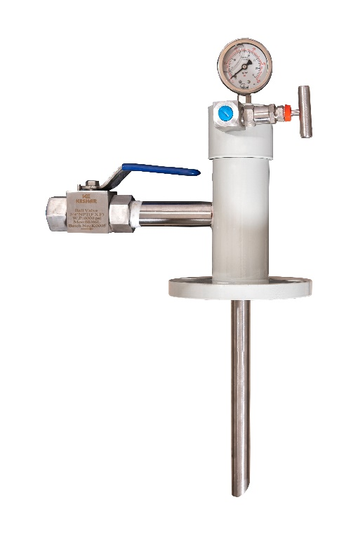
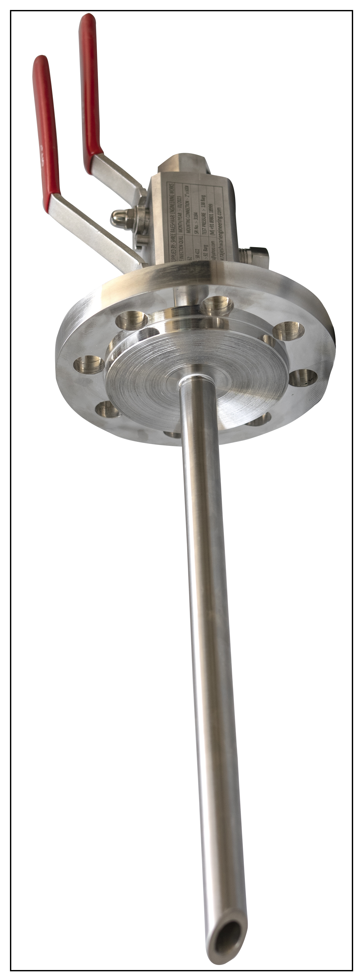
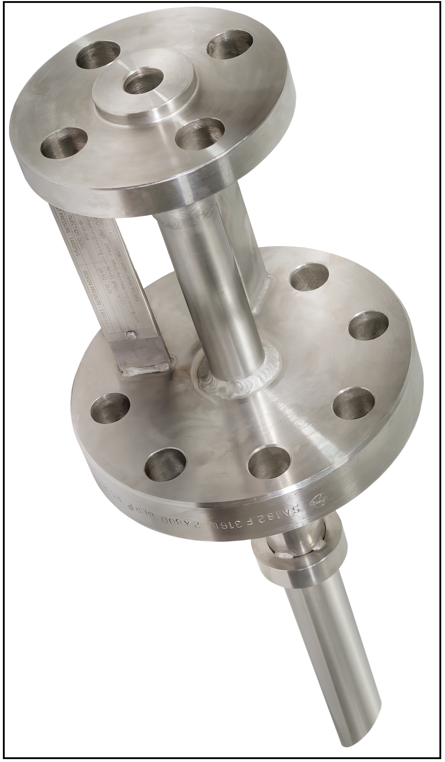
Chemical Injection Quills
A chemical injection quill is a piping specialty item, used to inject/transfer chemicals to main process fluid to achieve the required performance of main process fluid by efficient mixing with main process fluid.
Chemical injection quill also save the process header at the injection point from the corrosion / erosion by injecting at specified target location at process header.
Retrievable (RT Series) DBB (DB Series) Retrievable (SRT Series) Fixed (FXD Series)

Slide 9
NND OIL & GAS Injection Quill Series & Specifications
Series / Type:
  FXD Series (Fixed Type),
  RT Series (Retrievable Type)
  SRT Series (Self Retrievable Type),
  DB Series (Double Block & bleed type)
Capacity:
  1 to 1000 LPH
Pressure Rating:
  150, 300, 400, 600, 900, 1500, 2500 ANSI B16.5 Class
MOC:
  Carbon steel, Stainless Steel, Duplex Stainless steel, Inconel, Hastealloy, Titanium, Teflon, Polypropylene, etc.
Injection Nozzle Configuration:
  45 Degree Notch, 60 Degree Notch, Notch with groove, Hollow cone & full cone Spray nozzles, Perforated

Slide 10
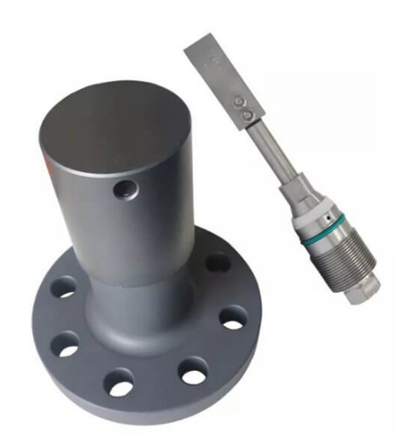
Corrosion Coupon
The corrosion coupon (weight loss) technique is the best known and simplest of all corrosion monitoring techniques. The method involves exposing a specimen of material (the coupon) to a process environment for a given duration, then removing the specimen for analysis. The basic measurement that is determined from corrosion coupons is weight loss; the weight loss taking place over the period of exposure being expressed as corrosion rate.

Slide 11
Inline Static Mixer/ Flow Mixer
Static Mixer is a device used to mix the miscible multiple fluid in process line without the need of power. It utilize the pressure of process fluid as power.
NND Oil & GAS designed static mixer provide 100% mixing efficiency for miscible liquid through its special components like end turbulator & fluid path breaker

Slide 12
NND OIL & GAS Static Mixer Series & Specifications
Series / Type:
  MXE Series (Static Mixer With End Turbulator)
  MX Series (Static Mixer Without End Turbulator)
Size:
  1” to 12”
Pressure Rating:
  150, 300, 400, 600, 900, 1500, 2500 ANSI B16.5 Class
MOC:
  Carbon steel, Stainless Steel, Duplex Stainless steel, Inconel, Hastealloy, Titanium, Teflon, Polypropylene, etc.
Efficiency:
  100% for miscible liquids
  Pressure Drop
  Less than 0.7 Bar

Slide 13
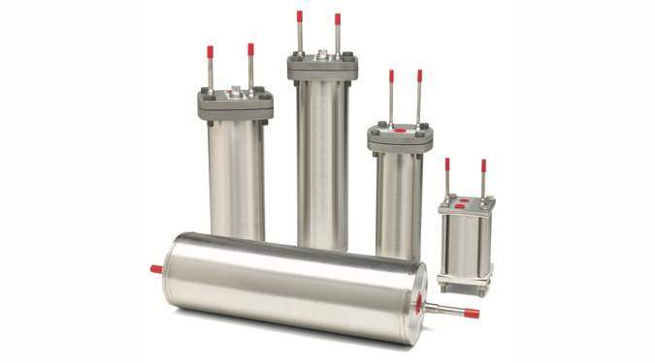
Sample Cooler
A sample cooler is used to cool a sample from a process stream. It may seem simple, but it is a uniquely designed small tube in a shell heat exchanger. The sample to be cooled flows through the tube side of the cooler, and the cooling fluid, usually water, flows through the shell side. The cooled sample then is taken to a laboratory for analysis or piped to in-line process instrumentation for continuous monitoring of properties.

Slide 14
NND OIL & GAS Sample Cooler Series & Specifications
Series / Type:
  SC Series
Capacity
  0.5 LPH to 250 LPH
Pressure Rating:
  150, 300, 400, 600, 900, 1500, 2500 ANSI B16.5 Class
MOC:
  Carbon steel, Stainless Steel, Duplex Stainless steel, Inconel, Hastealloy, Titanium, etc.
Temperature Range
  30 Degree Celsius to 400 Celsius
  Pressure Drop
  Less than 0.7 Bar

Slide 15
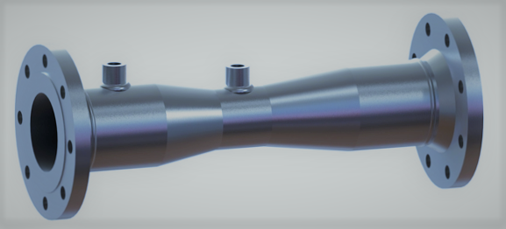
Venturi Meter
A Venturi meters are flow measurement instruments which use a converging section of pipe to give an increase in the flow velocity and a corresponding pressure drop from which the flowrate can be deduced. They have been in common use for many years

Slide 16
NND OIL & GAS Venturi Series & Specifications
Application: Flow measurement of Liquid or Gas
Series / Type:
  VN Series
Pressure Rating:
  150, 300, 400, 600, 900, 1500, 2500 ANSI B16.5 Class
MOC:
  Carbon steel, Stainless Steel, Duplex Stainless steel, Inconel, Hastealloy, Titanium, etc.
Temperature Range
  30 Degree Celsius to 400 Celsius

Slide 17
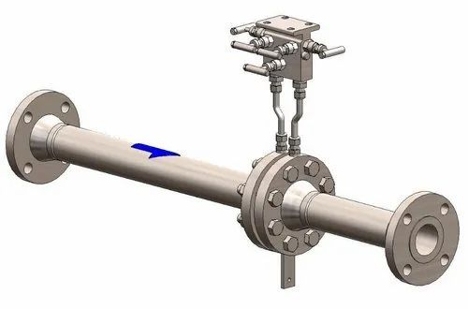
Orifice Meter
An orifice meter is a type of flow measurement device used to determine the flow rate of fluids, such as gases or liquids, through a pipeline or duct. It consists of a specially designed plate called an orifice plate, which is installed in the flow path. The orifice plate has a precisely machined hole, known as the orifice, through which the fluid passes.

Slide 18
NND OIL & GAS Orifice Series & Specifications
Application: Flow measurement of Liquid or Gas
Series / Type:
  OR Series
Pressure Rating:
  150, 300, 400, 600, 900, 1500, 2500 ANSI B16.5 Class
MOC:
  Carbon steel, Stainless Steel, Duplex Stainless steel, Inconel, Hastealloy, Titanium, etc.
Temperature Range
  30 Degree Celsius to 400 Celsius
  Additional Accessories:
  Flow profiler to reduce the straight length of upstream & downstream piping

Slide 19
New Products Addition to NND Portfolio
NND Oil & gas has added the Oil & Gas equipment's used in upstream industry as an expansion of the industry with their expertise in Oil & Gas.
List of newly added products to NND Oil & Gas Portfolio
  Separator
  Pressure vessels
  Scrubbers & KOD
  Enclosed Ground Flare system
  Indirect Bath Heaters
  Natural Draft Burner with burner Management system (New addition to portfolio)
  Forced Draft Burner with burner Management system (New addition to portfolio)

Slide 20





























Client List

